Slide 1
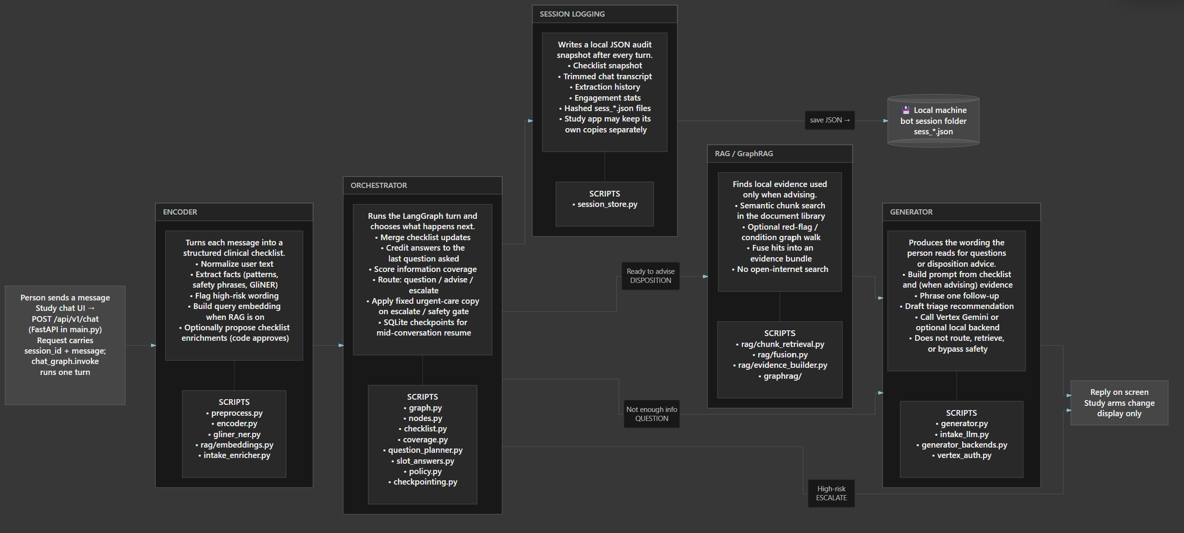

Slide 2

Arm 1
No clinical reasoning (low transparency)

Slide 3

Arm 2
CoT reasoning
(med transparency)

Slide 4
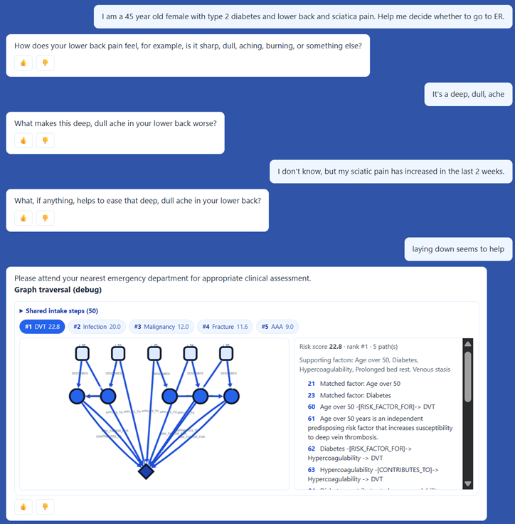
Arm 3
Knowledge graph
(high transparency)

